Slide 1
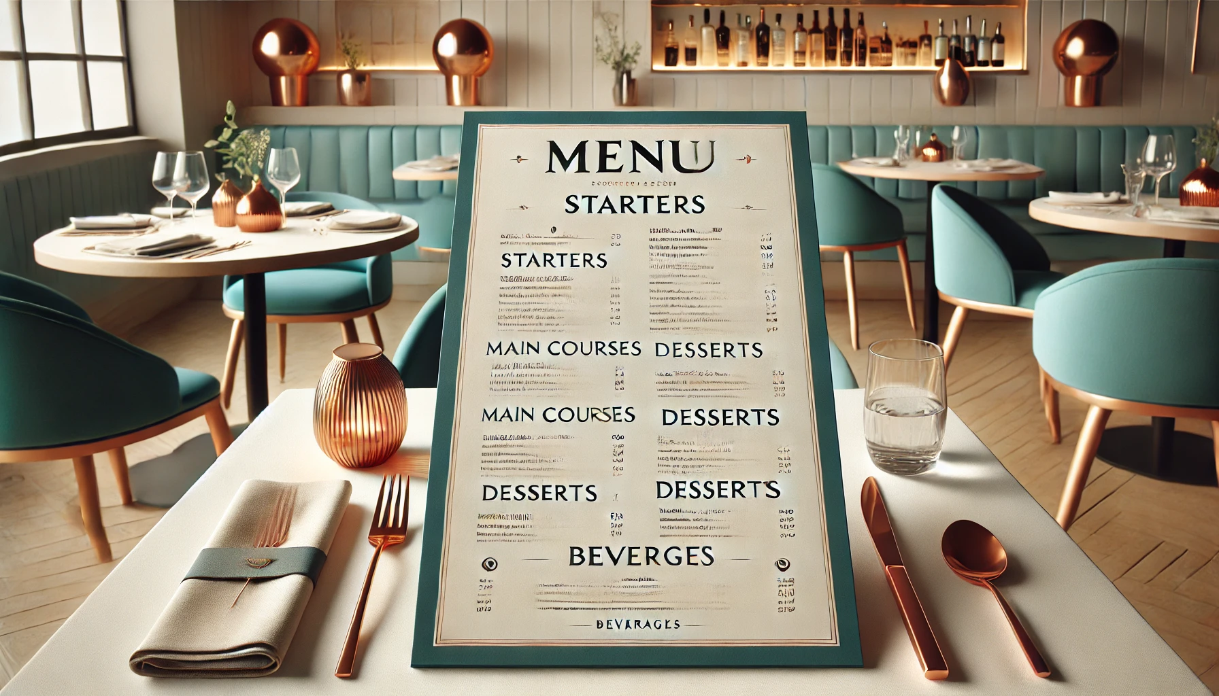
12 A.M Closed

Slide 2


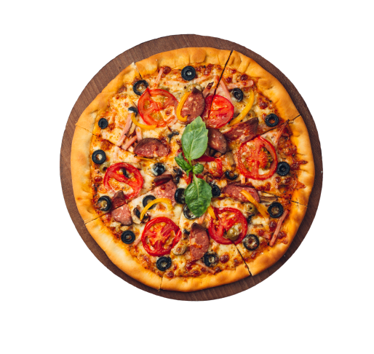
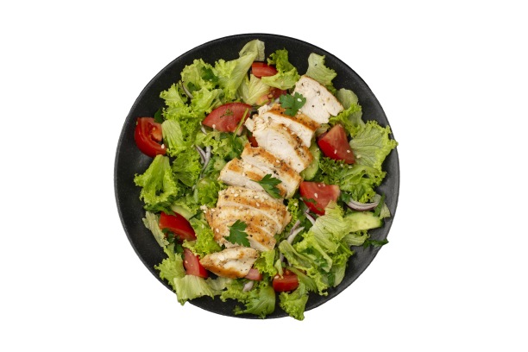
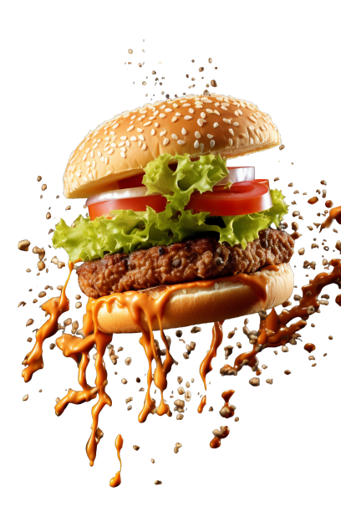
01 P.M Open

Slide 4
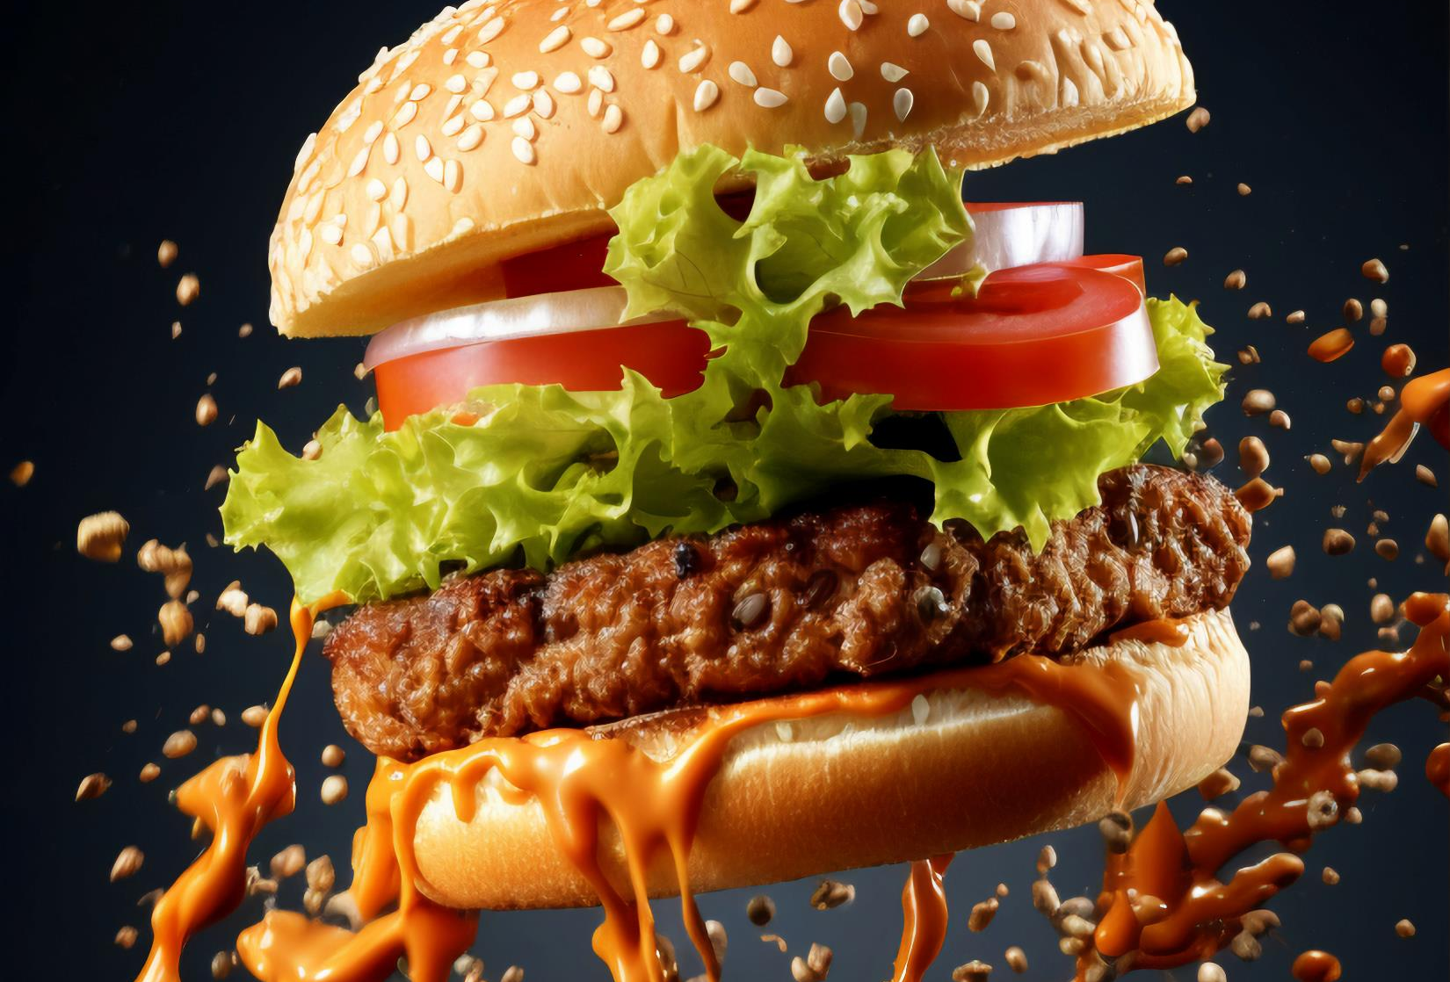
The Ultimate Juicy Burger
Sink your teeth into a perfectly grilled beef patty, bursting with rich, smoky flavor and oozing with juiciness. Topped with melted cheddar, crisp lettuce, vine-ripened tomatoes, and caramelized onions, all nestled inside a soft, toasted brioche bun. Finished with our signature tangy sauce that adds just the right kick. This is not just a burger—it’s an unforgettable flavor experience with every bite!

Slide 5
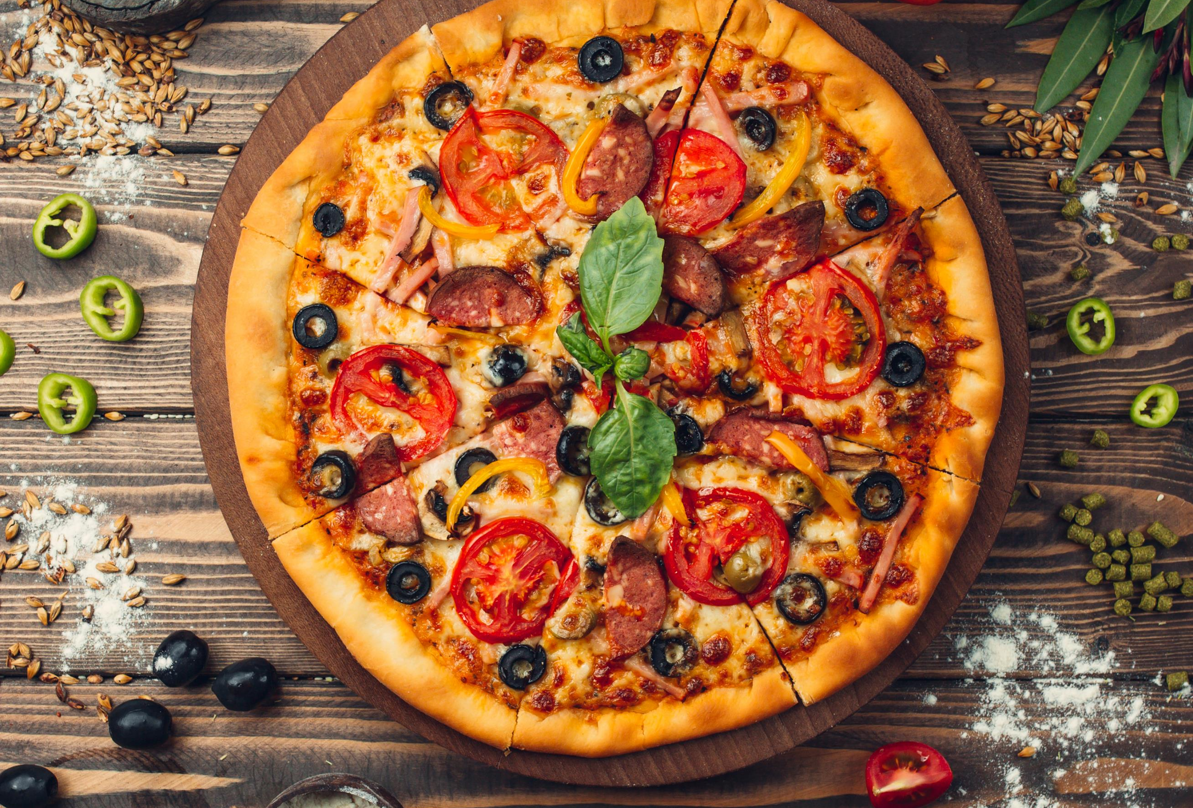
The Ultimate Cheesy Pizza
Indulge in a perfectly baked pizza, featuring a crispy, golden crust that strikes the ideal balance between chewy and crunchy. Topped with a generous layer of melted mozzarella, zesty marinara sauce, and your choice of fresh toppings, each slice bursts with flavor. Finished with a sprinkle of aromatic herbs and a drizzle of extra virgin olive oil, this pizza offers a mouthwatering experience that will leave you craving more!

Slide 6
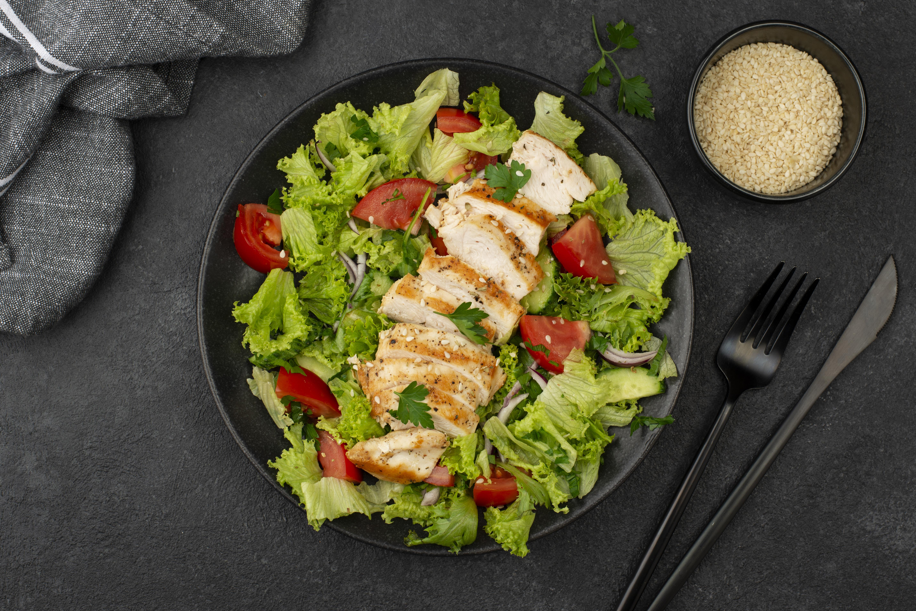
The Fresh Garden Salad
Experience a vibrant medley of crisp, garden-fresh vegetables, including crunchy romaine lettuce, juicy cherry tomatoes, refreshing cucumber slices, and colorful bell peppers. Topped with tangy feta cheese and a sprinkle of toasted sunflower seeds for added crunch, this salad is drizzled with a zesty lemon vinaigrette that perfectly complements the flavors. Each bite offers a burst of freshness and nutrition, making it a delightful and healthy choice!

Slide 7

Freshly Squeezed Orange Juice
Quench your thirst with our freshly squeezed orange juice, bursting with the bright, zesty flavor of sun-ripened oranges. Each glass is filled with the pure essence of juicy oranges, delivering a refreshing and revitalizing experience. Packed with vitamin C, this vibrant juice is not just delicious but also a healthy choice. Enjoy it chilled for the ultimate thirst quencher that brightens your day!

